Slide 1
Deep Learning Fundamentals
© Templateswise.com
ANKIT MIRAJKAR

Slide 2
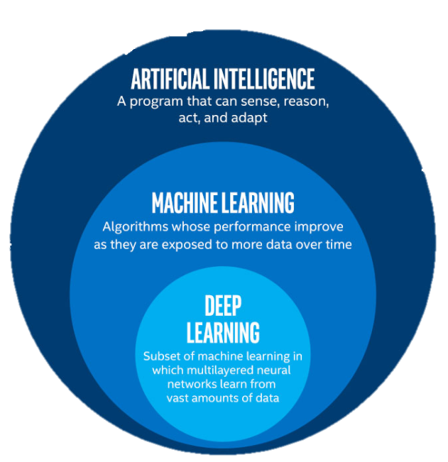
What is the difference between Artificial Intelligence, Machine Learning and Deep Learning?
Notes:
Artificial Intelligence is the overarching concept of machines mimicking human intelligence. This section covers what AI is, its historical evolution, and the main areas where it is applied.

Slide 3
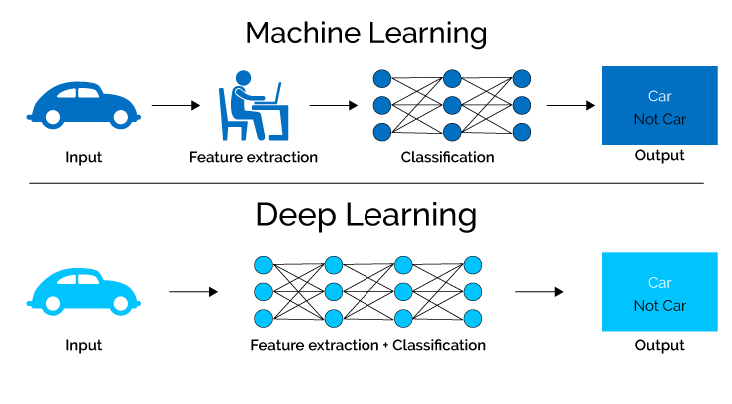
WHAT IS DEEP LEARNING?
Deep learning is a type of machine learning that imitates the way humans gain certain types of knowledge.
Deep Learning is based on artificial neural networks (ANNs) with multiple layers, also known as deep neural networks (DNNs)
These neural networks are inspired by the structure and function of the human brain, and they are designed to learn from large amounts of data in an unsupervised or semi-supervised manner.
Deep Learning models are able to automatically learn features from the data, which makes them well-suited for tasks such as image recognition, speech recognition, and natural language processing.

Slide 4
WHY DEEP LEARNING?
Problems with long list of rules: when traditional approach fails, Machine Learning/Deep Learning may help.
Continually changing environments: Deep Learning can adapt (“learn”) new scenarios.
Discovering insights within large collections of data: Can you imagine trying to hand-craft rules for what 101 different kinds of food looks like?
What DEEP LEARNING is not good for?
When you need explainability – Patterns learned by deep learning are typically uninterpretable by human.
When the traditional approach is better option – if you can accomplish what you need with a simple rule-based system
When errors are unacceptable – Since the output of deep learning models aren’t always predictable
When you don’t have much data – Deep learning model usually require a fairly large amount of data to produce great results

Slide 5
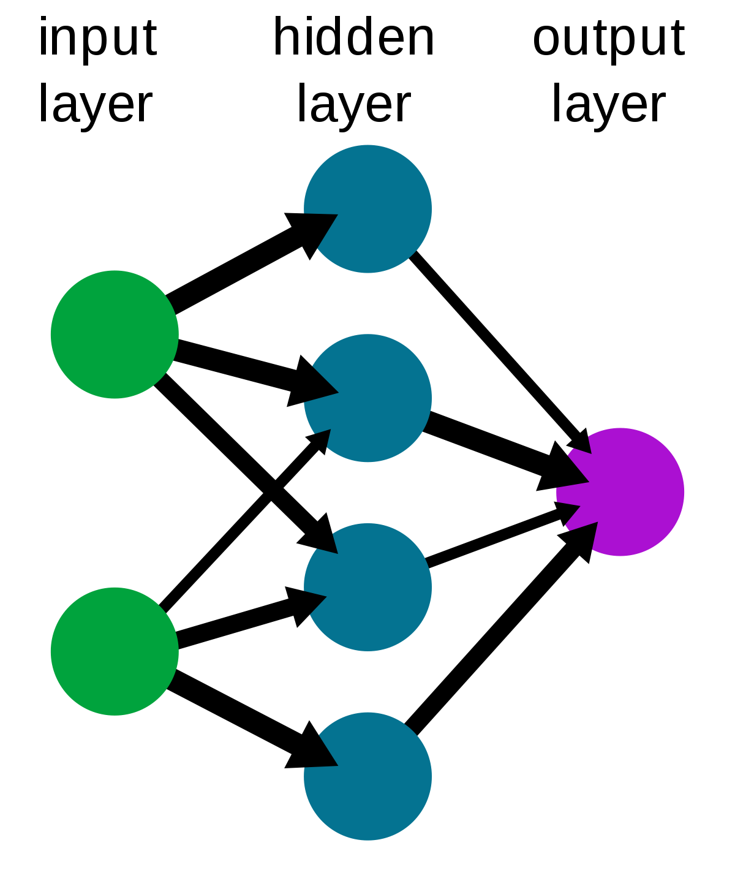
What is neural networks?
A neural network is a computing model whose layered structure resembles the networked structure of neurons in the brain
Artificial Neural Networks are normally called Neural Networks (NN) which is composed of layers of node
Each node is designed to behave similarly to a neuron in the brain
The first layer of a neural net is called the input layer, followed by hidden layer, then finally the output layer
Each node in the neural net performs some sort of calculation, which is passed on to other nodes deeper in the neural net

Slide 6
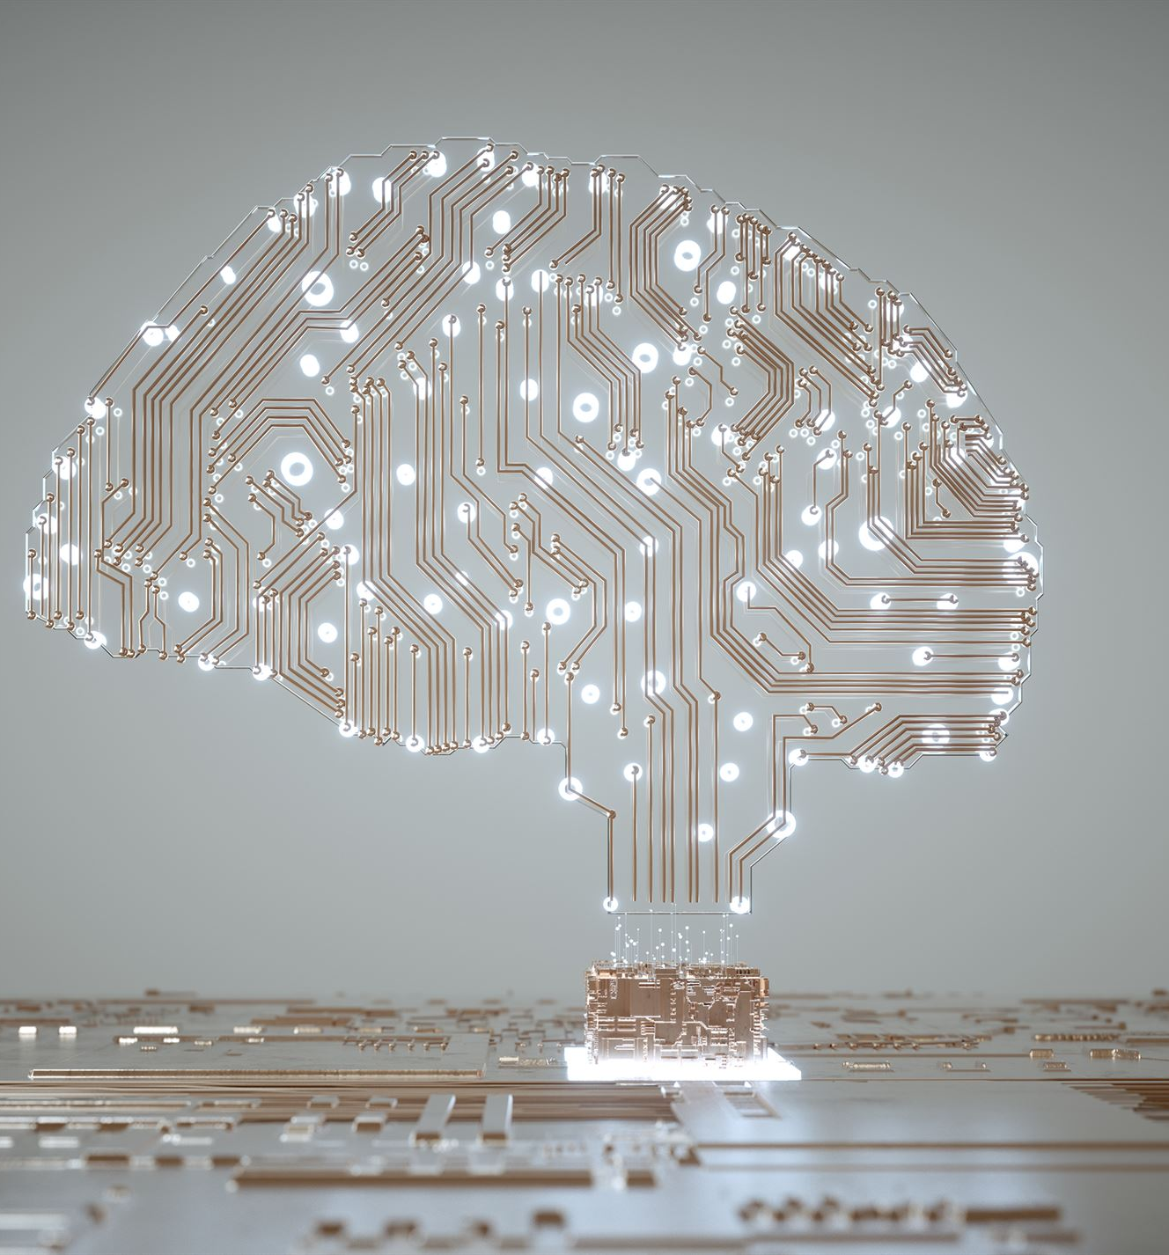
Rule of Thumb
Start with traditional ML — it’s simpler, faster, and interpretable.
Move to Deep Learning only when:
Data is unstructured or very large
Simpler ML models hit a performance ceiling
Notes:
---
Artificial Intelligence refers to computer systems designed to perform tasks that normally require human intelligence, such as reasoning, learning, problem-solving, and understanding natural language.
Image source: Microsoft 365 content library

Slide 7
Quick Comparison
Factor | Machine Learning | Deep Learning
Data type | Structured | Unstructured (image, text, audio)
Data size | Small to medium | Large
Feature engineering | Manual | Automatic
Training time | Fast | Slow
Compute required | CPU | GPU/TPU
Interpretability | High | Low
Accuracy (with large data) | Moderate | High
Examples | Logistic Regression, XGBoost | CNN, Transformer, LSTM
Notes:
---
AI has evolved from early symbolic reasoning and rule-based systems to modern data-driven approaches. Key milestones include the development of expert systems, neural networks, and recent advances in deep learning.
Image source: Microsoft 365 content library

Slide 8

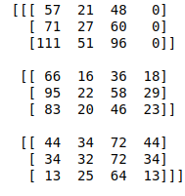
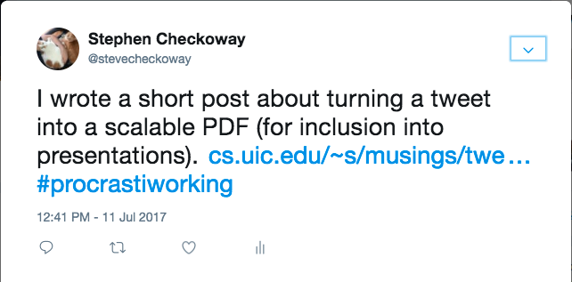
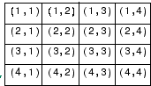
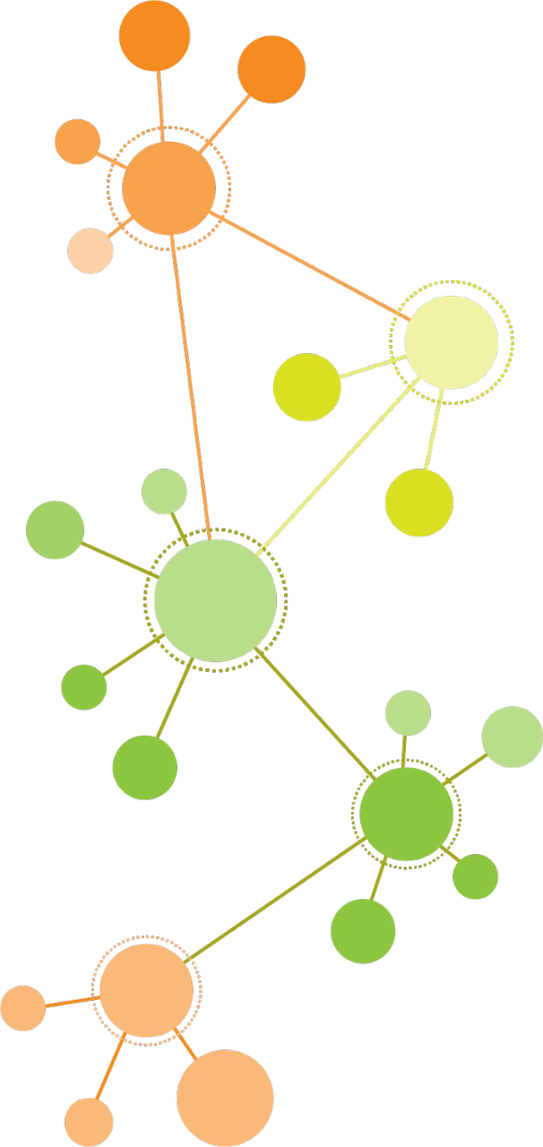

Before data gets used with neural network, it needs to be turned into numbers
Burger
PDF Link
“Hey Siri, play some song”
NUMERICAL ENCODING
LEARNS REPRESENTATIONS
REPRESENTATION
OUTPUT
OUTPUT
INPUTS

Slide 9

What is TENSORFLOW?
TensorFlow is a Python-friendly open source library for numerical computation that makes machine learning and developing neural networks faster and easier
End-to-end machine learning platform
Able to access many pre-built deep learning models (TensorFlow hub)
Whole stack: Preprocess data, model data, deploy data in your application
Originally designed and used in-house by Google (now open-source)
Applications and uses
Image and Face recognition
HealthCare related applications like cancer, etc.
Recommendation Systems
Virtual Assistants
Self-driving cars
Natural Language Processing

Slide 10
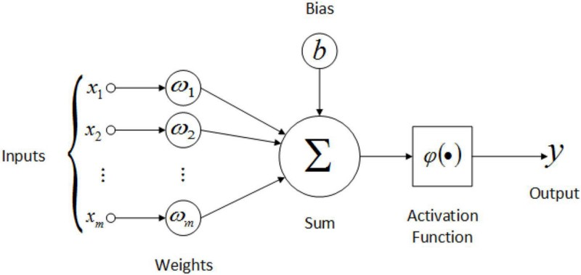
Types of Deep Learning Networks
FEED FORWARD NEURAL NETWORK:
A Feed Forward Neural Network is an artificial Neural Network in which the nodes are connected circularly. The data always flows in one direction and never backwards/opposite. A sequence of inputs enter the layer and are multiplied by the weights in this model. The weighted input values are then summed together to form a total.
If the sum of the values is more than a predetermined threshold, which is normally set at zero, the output value is usually 1, and if the sum is less than the threshold, the output value is usually -1. The single-layer perceptron is a popular feed-forward neural network model that is frequently used for classification.
Applications:
Data Compression
Pattern Recognition
Computer Vision
Sonar Target Recognition
Speech Recognition
Handwritten Characters Recognition

Slide 11
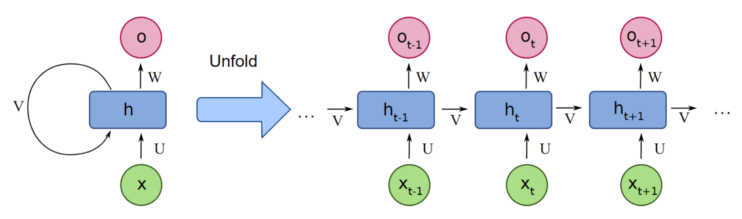
Types of Deep Learning Networks
RECURRENT NEURAL NETWORK:
A recurrent neural network (RNN) is a type of artificial neural network which uses sequential data or time series data. The Recurrent neural network mainly accesses the preceding info of existing iterations. It does not let the size of the model to increase with the increase in the input size. However, the only problem with this recurrent neural network is that it has slow computational speed as well as it does not contemplate any future input for the current state. It has a problem with reminiscing prior information.
Applications:
Machine Translation
Robot Control
Time Series Prediction
Speech Recognition
Speech Synthesis
Time Series Anomaly Detection
Rhythm Learning
Music Composition
Notes:
Let’s say while watching a video, you remember the previous scene, or while reading a book, you know what happened in the earlier chapter. RNNs work similarly; they remember the previous information and use it for processing the current input.

Slide 12
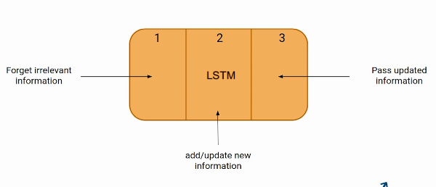
LONG SHORT-TERM MEMORY(LSTM) NETWORKS
Long Short-Term Memory Networks is a deep learning, sequential neural network that allows information to persist. It is a special type of Recurrent Neural Network which is capable of handling the vanishing gradient problem faced by RNN.
The shortcoming of RNN is they cannot remember long-term dependencies due to vanishing gradient. LSTMs are explicitly designed to avoid long-term dependency problems.
LSTM Architecture
The LSTM network architecture consists of three parts, as shown in the image below, and each part performs an individual function
The first gate is called Forget gate, the second gate is known as the Input gate, and the last one is the Output gate

Slide 13
STEPS:
The first part chooses whether the information coming from the previous timestamp is to be remembered or is irrelevant and can be forgotten.
In the second part, the cell tries to learn new information from the input to this cell.
At last, in the third part, the cell passes the updated information from the current timestamp to the next timestamp. This one cycle of LSTM is considered a single-time step.
Some of the applications of LSTM includes:
Language Modeling: LSTMs have been used for natural language processing tasks such as language modeling, machine translation, and text summarization. They can be trained to generate coherent and grammatically correct sentences by learning the dependencies between words in a sentence.
Speech Recognition: LSTMs have been used for speech recognition tasks such as transcribing speech to text and recognizing spoken commands. They can be trained to recognize patterns in speech and match them to the corresponding text.
Time Series Forecasting: LSTMs have been used for time series forecasting tasks such as predicting stock prices, weather, and energy consumption. They can learn patterns in time series data and use them to make predictions about future events.
Anomaly Detection: LSTMs have been used for anomaly detection tasks such as detecting fraud and network intrusion. They can be trained to identify patterns in data that deviate from the norm and flag them as potential anomalies.

Slide 14
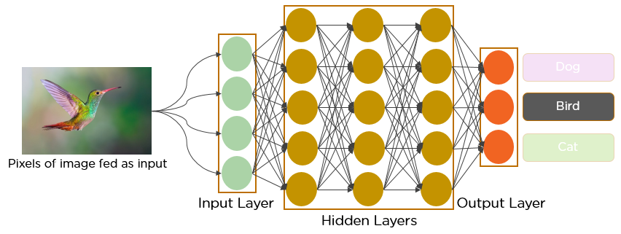
Types of Deep Learning Networks
CONVOLUTIONAL NEURAL NETWORK:
Convolutional neural network (CNN/ConvNet) is a class of deep neural networks, most commonly applied to analyze visual imagery. A digital image is a binary representation of visual data. It contains a series of pixels arranged in a grid-like fashion that contains pixel values to denote how bright and what color each pixel should be. DNNs enable unsupervised construction of hierarchical image representations. To achieve the best accuracy, deep convolutional neural networks are preferred more than any other neural network.
Applications:
Identify Faces, Street Signs, Tumors
Image Recognition
Video Analysis
NLP
Anomaly Detection
Drug Discovery
Checkers Game
Time Series Forecasting

Slide 15
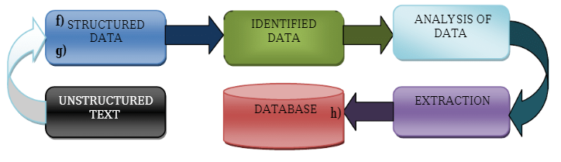
TEXT MINING
Text mining is the process of extracting information from text data.
It involves a variety of tasks such as text categorization, text clustering, concept/entity extraction, sentiment analysis, document summarization, and context-related modeling
ADVANTAGES:
It structures unstructured data for further analysis.
It reduces the risks of false insights.
It creates informative decisions, automotive processes, and research analysis.
Notes:
Gathering unstructured data from multiple data sources like plain text, web pages, pdf files, emails, and blogs, to name a few.
Detect and remove anomalies from data by conducting pre-processing and cleansing operations. Data cleansing allows you to extract and retain the valuable information hidden within the data and to help identify the roots of specific words.
For this, you get a number of text mining tools and text mining applications.
Convert all the relevant information extracted from unstructured data into structured formats.
Analyze the patterns within the data via the Management Information System (MIS).
Store all the valuable information into a secure database to drive trend analysis and enhance the decision-making process of the organization.

Slide 16
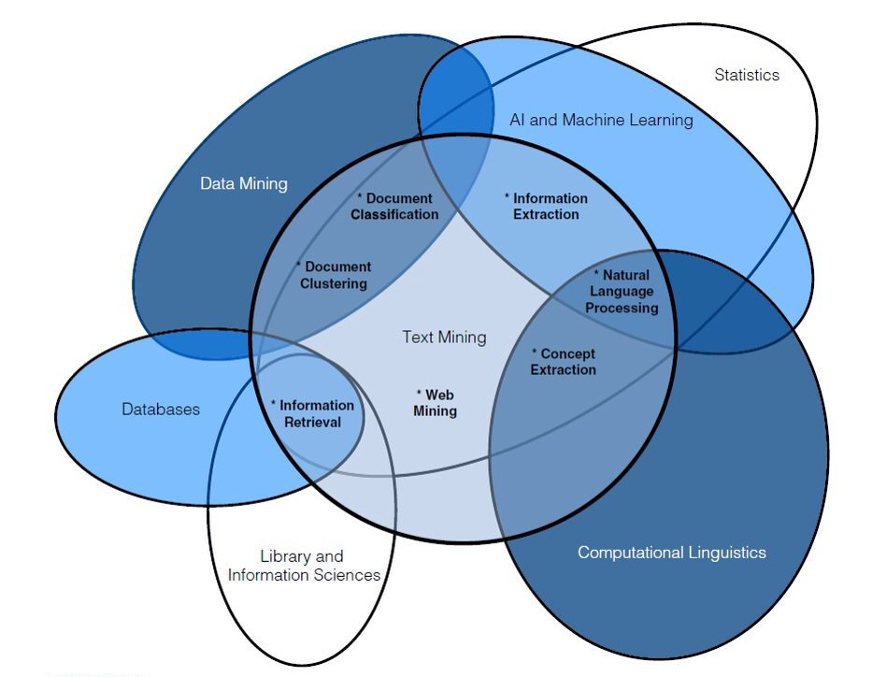
APPLICATIONS OF TEXT MINING
Information Extraction: Identification and extraction of relevant facts from the unstructured data.
Document classifications and clustering: It aims for grouping and categorizes terms by classifications and clustering methods.
Information Retrieval: It aims at stringifying the retrieved text in a text document.
Natural Language Processing: It is a major part of text mining. Here we use different computational tasks for understanding and analyzing the unstructured data from a text file.

